Slide 2
Presented by Atie Moghtadaie

Slide 4
Objective
This article summarizes current concepts of coagulation in cirrhosis, available tests used to predict bleeding, procedures and risk of bleeding, and the rationale and expert-based recommendations of prophylactic measures for patients with cirrhosis who undergo invasive procedures.

Slide 5
Introduction
Patients with cirrhosis have several hemostatic disturbances
Coagulation factors
Inhibitors of coagulation
Fibrinolytic factors
Low platelets
Hemostatic changes can lead to bleeding and clotting at the same time
It is so challenging to determine their real hemostatic status with currently available clinical tests
All available laboratory tests of hemostasis have major limitations in patients with cirrhosis and lack data, especially as preprocedure risk measures

Slide 7
Coagulation Tests In Cirrhosis
Platelets
Levels below 50,000 occur in less than 2% of patients
Elevated vWF
Elevated plt activity
Prothrombin time and the INR
Measures procoagulant factors I, II, V, VII, and X
Does not evaluate the status of anticoagulant factors such as protein C, S, or antithrombin

Slide 9
There Are Several Concomitant Situations That Significantly Impact On Hemostasis. They Are Not Assessed By The Laboratory Tests But Need To Be Acknowledged, Because They Can Tip The Balance.
1. Volume status, portal-collateral pressure, and flow are important considerations. Volume administration/restriction interferes with coagulation factors and platelet concentration. Most bleeding in cirrhosis is related to portal hypertension, which should be lowered as the first hemostatic measure.
2. For rheological reasons, once the hematocrit level drops below 25%, the erythrocyte concentration is insufficient to adequately push platelets toward vessel walls, reducing the platelet - endothelium interaction.
3. Infections can lead to an additional increase in vWF levels (abnormally high in patients with cirrhosis), which elevates the risk for clotting. vWF levels may proportionally increase with the lipopolysaccharide blood concentration.
4. Renal failure reduces the adhesive and aggregative properties of platelets.Acute kidney injury has been associated with an increased risk of bleeding after low-risk procedures such as paracentesis in patients with decompensated cirrhosis.

Slide 10
There Are Several Concomitant Situations That Significantly Impact On Hemostasis. They Are Not Assessed By The Laboratory Tests But Need To Be Acknowledged, Because They Can Tip The Balance.
5. Occult bleeding from gastrointestinal origin is common in patients with cirrhosis and can lead to iron deficiency that may increase the risk of clotting. Hypercoagulability in children with iron deficiency can be detected by thromboelastometry.
6. Although controversial, bleeding can be attributed to hyperfibrinolysis. Current laboratory measures do not assess fibrinolysis, and thromboelastometry may not be sensitive enough to detect it. Hyperfibrinolysis can cause spontaneous mucocutaneous and other unusual bleeding manifestations and is more common in patients with decompensated cirrhosis and in those with acute liver failure.

Slide 11
Thresholds and Bleeding Risk
INR was developed to monitor anticoagulation with warfarin. The administration of fresh frozen plasma before an invasive procedure can worsen portal hypertension and in addition does not change thrombin production
platelet levels over 50,000 mL promote thrombin generation
The most accepted target for platelet prophylaxis is the cut off less than 50,000 m/L platelets;
the thresholds vary depending on the risk of the procedure and concomitant clinical scenario . This value has ranged between 30.000 and 75.000
Bleeding on admission, platelet count less than 30,000 u/L, fibrinogen level less than 60 mg/dL, and activated partial thromboplastin time values greater than 100 seconds were the strongest independent predictors for new onset of major bleeding in a multivariate regression analysis.

Slide 12
Clinical Scenarios

Slide 13
Prophylactic Transfusion Prophylaxis Of Bleeding Before Invasive Procedures
There are no data to support a specific INR or platelet cutoff in which procedural bleeding risk is elevated. Therefore, because no solid data support transfusion thresholds, decisions need to be individualized.

Slide 14
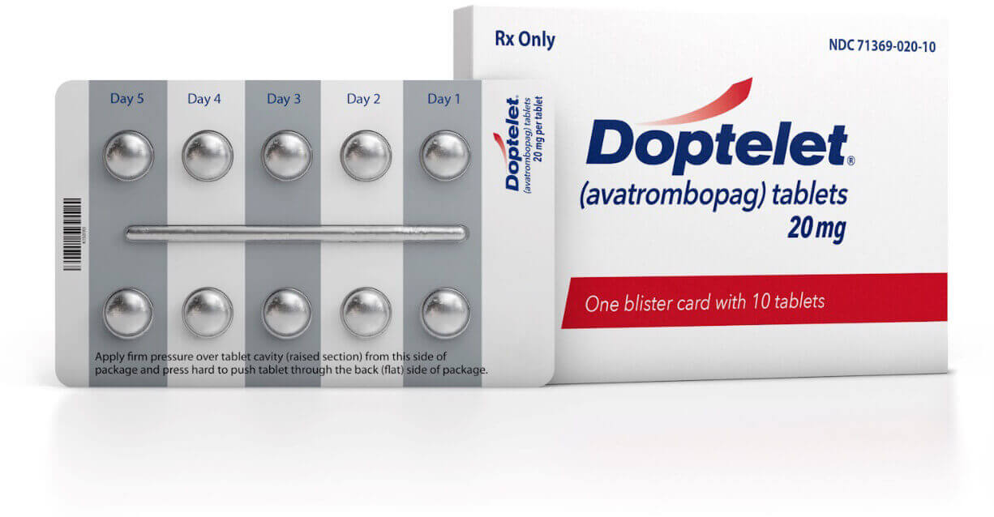
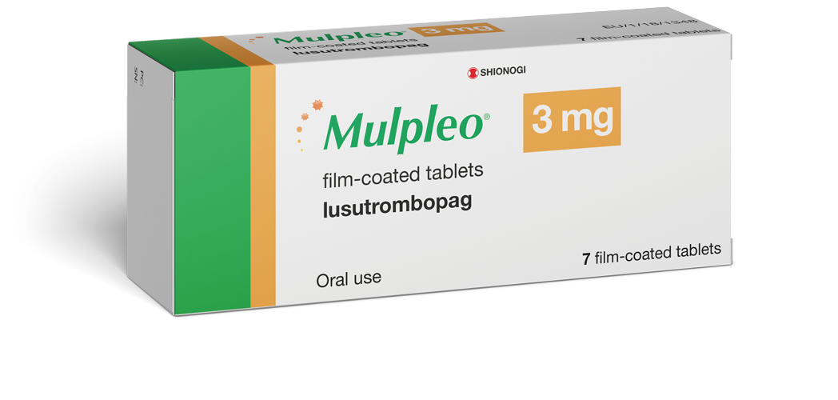
Thrombocytopenia

Slide 15
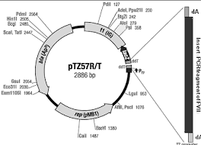
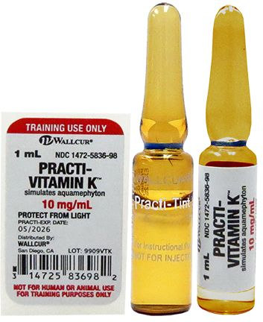
Factor Deficiencies

Slide 16
Low Fibrinogen
low fibrinogen levels (<100 mg/dL) can be associated with spontaneous and procedure-related bleeding in critically ill patients with cirrhosis
Hyperfibrinolysis is also uncommon in patients with cirrhosis, but there are no commercially available tests to evaluate hyperfibrinolysis in clinical practice.
There are scarce data on the use of fibrinogen-rich products in cirrhosis. These include cryoprecipitates and fibrinogen concentrate. Both increase fibrinogen levels in patients with cirrhosis, but there are no data to indicate that they prevent bleeding
Fibrinogen concentrate contains 1 g per vial, and the doses are based on baseline fibrinogen level (usually <100 mg/dL) and range from 2 to 4 g with a half-life of 2 to 3 days.

Slide 17
Prophylaxis And Active Bleeding
In most cases active bleeding in cirrhosis patients is related to portal hypertension. The authors use transfusion thresholds similar to those for high-risk procedures and during an acute bleed, the authors aim for a platelet count greater than 50,000 and fibrinogen levels above 100 mg/dL. Hemoglobin of 7 to 8 g/dL is the recommended target transfusion for red blood cells.
Fluid administration and hemodynamic monitoring should be considered as a part of hemostatic treatment. If fluids are needed (ie, hypotension/shock), the authors favor the use of crystalloids. Vasoactive drugs (somastostatin, terlipressin) are recommended to maintain mean arterial pressure greater than 65 mm Hg.

Slide 18
Current Recommendations Based On Available Evidence
Most available data on testing for bleeding risk in cirrhosis are not validated. The standard tests used for the evaluation of hemostasis are the platelet count and fibrinogen.
The INR level is not recommended as a test that predicts bleeding risk.
Global tests of clot formation, such as ROTEM and TEG, are promising but need to be validated, and they need to evaluate the risk of bleeding, not only thresholds for transfusion. The authors do not routinely correct thrombocytopenia and coagulopathy before common low-risk procedures such as diagnostic paracentesis and routine upper endoscopy.

Slide 19
Current Recommendations Based On Available Evidence
The transfusion of platelets or fibrinogen carries a risk of transfusion-related acute lung injury and/or transfusion reactionsThe INR level is not recommended as a test that predicts bleeding risk.
The authors advise against using FFP as it does not improve hemostasis and can cause circulatory overload.
The authors do consider transfusion of platelets and/or fibrinogen for management of active bleeding and/or low- to high-risk procedures. They aim for a hemoglobin level greater than 7 g/L, platelet count greater than 30,000 to 50,000 m/L, and fibrinogen greater than 100 mg/dL.
Thrombopoietin agonists are promising and an adequate replacement of platelet transfusion in scheduled procedures.

Slide 22
References
1. Lisman T, Porte RJ. Rebalanced hemostasis in patients with liver disease: Evidence and clinical consequences. Blood 2010;116(6):878–85.
2. Fisher C, Patel VC, Stoy SH, et al. Balanced haemostasis with both hypo- and hyper-coagulable features in critically ill patients with acute-on-chronic-liver failure. J Crit Care 2018;43:54–60.
3. Blasi A. Coagulopathy in liver disease: lack of an assessment tool. World J Gastroenterol 2015;21(35):10062–71.
4. Lisman T, Bongers TN, Adelmeijer J, et al. Elevated levels of von Willebrand factor in cirrhosis support platelet adhesion despite reduced functional capacity. Hepatology 2006;44(1):53–61.
5. Davı` G, Ferro D, Basili S, et al. Increased thromboxane metabolites excretion in liver cirrhosis. Thromb Haemost 1998;79(4):747–51.
6. Trotter JF, Brimhall B, Arjal R, et al. Specific laboratory methodologies achieve higher model for endstage liver disease (MELD) scores for patients listed for liver transplantation. Liver Transplant 2004;10(8):995–1000.
7. Magnusson M, Sten-Linder M, Bergquist A, et al. The international normalized ratio according to Owren in liver disease: interlaboratory assessment and determination of international sensitivity index. Thromb Res 2013;132(3):346–51.
8. Tripodi A, Primignani M, Chantarangkul V, et al. An imbalance of pro- vs anticoagulation factors in plasma from patients with cirrhosis. Gastroenterology 2009;137(6):2105–11.

Slide 23
References
9. Drolz A, Horvatits T, Roedl K, et al. Coagulation parameters and major bleeding in critically ill patients with cirrhosis. Hepatology 2016;64(2):556–68.
10. Bolliger D, Szlam F, Molinaro RJ, et al. Finding the optimal concentration range for fibrinogen replacement after severe haemodilution: an in vitro model. Br J Anaesth 2009;102(6):793–9.
11. Palascak JE, Martinez J. Dysfibrinogenemia associated with liver disease. J Clin Invest 1977;60(1):89–95.
12. Miesbach W, Schenk J, Alesci S, et al. Comparison of the fibrinogen Clauss assay and the fibrinogen PT derived method in patients with dysfibrinogenemia. Thromb Res 2010;126(6):e428–33.
13. Abeysundara L, Mallett SV, Clevenger B. Point-of-care testing in liver disease and liver surgery. Semin Thromb Hemost 2017;43(4):407–15.
14. Kleinegris MC, Bos MHA, Roest M, et al. Cirrhosis patients have a coagulopathy that is associated with decreased clot formation capacity. J Thromb Haemost 2014;12(10):1647–57.
15. De Pietri L, Bianchini M, Montalti R, et al. Thrombelastography-guided blood product use before invasive procedures in cirrhosis with severe coagulopathy: a randomized, controlled trial. Hepatology 2016;63(2):566–73.
16. De Pietri L, Bianchini M, Rompianesi G, et al. Thromboelastographic reference ranges for a cirrhotic patient population undergoing liver transplantation. World J Transplant 2016;6(3):583.
17. Thai C, Oben C, Wagner G. Coagulation, hemostasis, and transfusion during liver transplantation. Best Pract Res Clin Anaesthesiol 2020;34(1):79–87.
18. Massicotte L, Carrier FM, Denault AY, et al. Development of a predictive model for blood transfusions and bleeding during liver transplantation: an observational cohort study. J Cardiothorac Vasc Anesth 2018;32(4):1722–30.

Slide 24
References
19. Weeder PD, Porte RJ, Lisman T. Hemostasis in liver disease: Implications of new concepts for perioperative management. Transfus Med Rev 2014;28(3):107–13.
20. Fernandez F, Goudable C, Sie P, et al. Low haematocrit and prolonged bleeding time in uraemic patients: effect of red cell transfusions. Br J Haematol 1985;59(1): 139–48.
21. Mandorfer M, Schwabl P, Paternostro R, et al. Von Willebrand factor indicates bacterial translocation, inflammation, and procoagulant imbalance and predicts complications independently of portal hypertension severity. Aliment Pharmacol Ther 2018;47(7):980–8.
22. Kalambokis GN, Oikonomou A, Christou L, et al. von Willebrand factor and procoagulant imbalance predict outcome in patients with cirrhosis and thrombocytopenia. J Hepatol 2016;65(5):921–8.
23. Lutz J, Menke J, Sollinger D, et al. Haemostasis in chronic kidney disease. Nephrol Dial Transplant 2014;29:29–40.
24. Patel IJ, Rahim S, Davidson JC, et al. Society of Interventional Radiology consensus guidelines for the periprocedural management of thrombotic and bleeding risk in patients undergoing percutaneous image-guided interventions—part II: recommendations: endorsed by the Canadian Association for Interventional Radiology and the Cardiovascular and Interventional Radiological Society of Europe. J Vasc Interv Radiol 2019;30(8):1168–84.e1.
25. O¨ zdemir ZC, Du¨zenli Kar Y, Gu¨ndu¨z E, et al. Evaluation of hypercoagulability with rotational thromboelastometry in children with iron deficiency anemia. Hematology 2018;23(9):664–8.
26. Hu KQ, Yu AS, Tiyyagura L, et al. Hyperfibrinolytic activity in hospitalized cirrhotic patients in a referral liver unit. Am J Gastroenterol 2001;96(5):1581–6.
27. Zimmon DS, Kessler RE. The portal pressure-blood volume relationship in cirrhosis. Gut 1974;15:99–101.
28. Tripodi A, Primignani M, Chantarangkul V, et al. Thrombin generation in patients with cirrhosis: the role of platelets. Hepatology 2006;44(2):440–5.
29. Giannini EG, Greco A, Marenco S, et al. Incidence of bleeding following invasive procedures in patients with thrombocytopenia and advanced liver disease. Clin Gastroenterol Hepatol 2010;8(10):899–902.
30. O’Leary J, Greenberg CS, Patton HM, et al. AGA clinical practice update: coagulation in cirrhosis. Gastroenterology 2019;157(1):34–43.e1.

Slide 25
References
31. Intagliata NM, Argo CK, Stine JG, et al. Concepts and controversies in haemostasis and thrombosis associated with liver disease: proceedings of the 7th international coagulation in liver disease conference. Thromb Haemost 2018;118(8): 1491–506.
32. Vieira da Rocha EC, D’Amico EA, Caldwell SH, et al. A prospective study of conventional and expanded coagulation indices in predicting ulcer bleeding after variceal band ligation. Clin Gastroenterol Hepatol 2009;7:988–93.
33. Northup PG, Garcia-Pagan JC, Garcia-Tsao G, et al. Vascular liver disorders, portal vein thrombosis, and procedural bleeding in patients with liver disease: 2020 practice guidance by the American Association for the Study of Liver Diseases. Hepatology 2020. https://doi.org/10.1002/hep.31646
34. Peck-Radosavljevic M, Simon K, Iacobellis A, et al. Lusutrombopag for the treatment of thrombocytopenia in patients with chronic liver disease undergoing invasive procedures (L-PLUS 2). Hepatology 2019;70:1336–48.
35. Terrault N, Chen YC, Izumi N, et al. Avatrombopag before procedures reduces need for platelet transfusion in patients with chronic liver disease and thrombocytopenia. Gastroenterology 2018;155:705–18.
36. Rassi AB, d’Amico EA, Tripodi A, et al. Fresh frozen plasma transfusion in patients with cirrhosis and coagulopathy: effect on conventional coagulation tests and thrombomodulin-modified thrombin generation. J Hepatol 2020;72:85–94.
37. Kleinman S, Caulfield T, Chan P, et al. Toward an understanding of transfusionrelated acute lung injury: statement of a consensus panel. Transfusion 2004;44: 1774–89.
38. Bosch J, Thabut D, Albillos A, et al. Recombinant factor VIIa for variceal bleeding in patients with advanced cirrhosis: a randomized, controlled trial. Hepatology 2008;47:1604–14.
39. Massicotte L, Lenis S, Thibeault L, et al. Reduction of blood product transfusions during liver transplantation. Can J Anaesth 2005;52(5):545–6.

